Slide 1
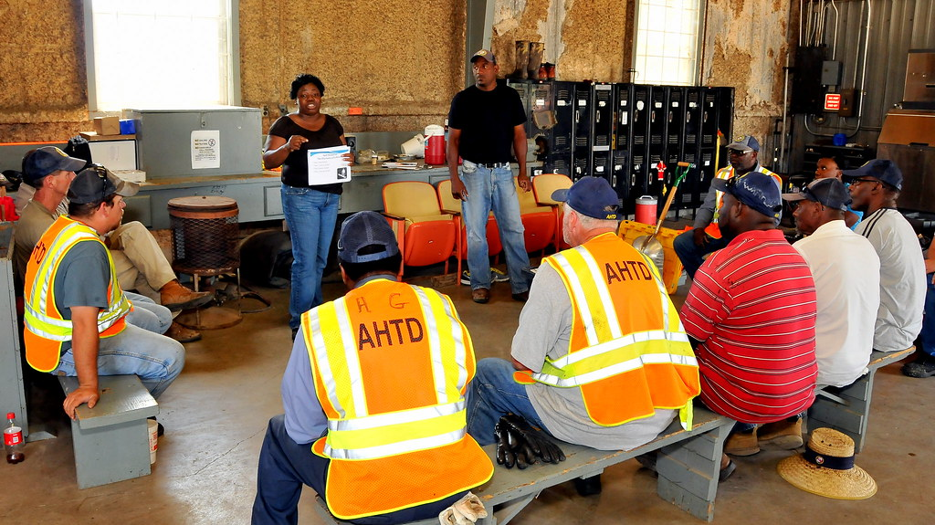

Slide 2

SAFETY DAY AGENDA
0800-0900: TOOL-BOX TALK & REVIEW OF ACCIDENTS/INCIDENTS
0900-1000: HAZARD IDENTIFICATION ROUNDS
1030-1115: READ OUT THE HAZARDS IDENTIFIED AND ASSIGN CORRECTIVE ACTIONS TO FOLLOW UP
1115-1200: IS MY PPE OKAY
1300- 1500: PSC ITEM ROUNDS - My safety checks
1530-1600: Discuss the ﬁndings of the PSC rounds and assign corrective actions.
1600- 1730: SHELL PIS TRAINING
1815: ASSEMBLE FOR “SAFETY-DINNER (BUFFET)”

